Slide 1
Personality Prediction Project
B Shruti
321810305017

Slide 2
Overview
The process of extracting the digital content into features and mapping it according to a personality model.
This project is based on identifying the personality of an individual using machine learning algorithms and big 5 model.
The personality of a human plays a major role in his personal and professional life.
Nowadays, many organizations have also started shortlisting the candidates based on their personality as this increase the efficiency of the work because the person is working in what he is good at than what he is forced to do.

Slide 3
Steps to build a personality prediction model:
Collect Data
Prepare the data
Choose the model
Training the machine model
Evaluation
Parameter Tuning
Prediction or Inference

Slide 4
Collect data
There are various ways to collect data and this process depends on the type of projects.
Or there will be the existing data sets, ready to feed into that model with all preprocessing that we can work upon.
The data can be gathered by web scrapping a website or application.
In most of the cases in real world there might not be an existing data for the project that we want work on.
Or the data is provided by the client, but machine learning engineers should not expect the data to be in a perfect shape.

Slide 5
Big Five model/Five-Factor Model (FFM) or OCEAN model
Five main components of personality are:
Openness
Conscientiousness
Extraversion
Agreeableness
Neuroticism

Slide 6
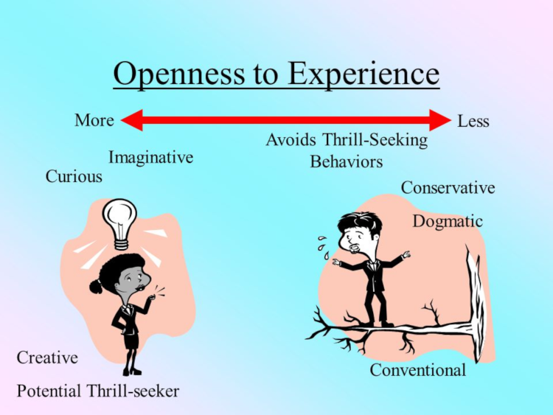
Openness
Openness is one of the five personality traits of the Big Five personality model. It indicates how open-minded a person is. A person with a high level of openness to experience in a personality test enjoys trying new things. They are imaginative, curious, and open-minded. Individuals who are low in openness to experience would rather not try new things. They are close-minded, literal and enjoy having a routine.
In short, high openness means being creative and open to new ideas

Slide 7
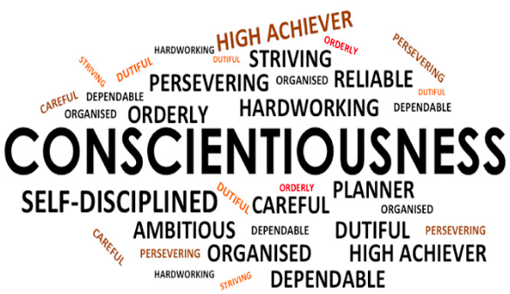
Conscientiousness
Conscientiousness is one of the five personality traits of the Big Five personality theory. A person scoring high in conscientiousness usually has a high level of self-discipline. These individuals prefer to follow a plan, rather than act spontaneously. Their methodic planning and perseverance usually makes them highly successful in their chosen occupation.
High conscientiousness means a person is responsible and reliable

Slide 8

Extraversion
Extraversion is one of the five personality traits of the Big Five personality theory. Extraversion indicates how outgoing and social a person is. A person who scores high in extraversion on a personality test is the life of the party. They enjoy being with people, participating in social gatherings, and are full of energy. A person low in extraversion is less outgoing and is more comfortable working by himself.
Person high in extraversion is outgoing and enthusiastic

Slide 9
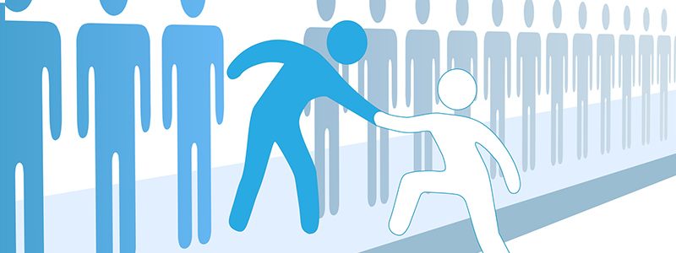
Agreeableness
Agreeableness is one of the five personality traits of the Big Five personality theory. A person with a high level of agreeableness in a personality test is usually warm, friendly, and tactful. They generally have an optimistic view of human nature and get along well with others. A person who scores low on agreeableness may put their own interests above those of others. They tend to be distant, unfriendly, and uncooperative.
Person high in agreeableness is friendly and helpful

Slide 10

Neuroticism
Emotional stability or neuroticism is one of the five personality traits of the Big Five personality theory. Emotional stability refers to a person's ability to remain stable and balanced. At the other end of the scale, a person who is high in neuroticism has a tendency to easily experience negative emotions.
Some psychologists prefer to call neuroticism by the term emotional instability
Individual high in neuroticism is emotionally reactive

Slide 11
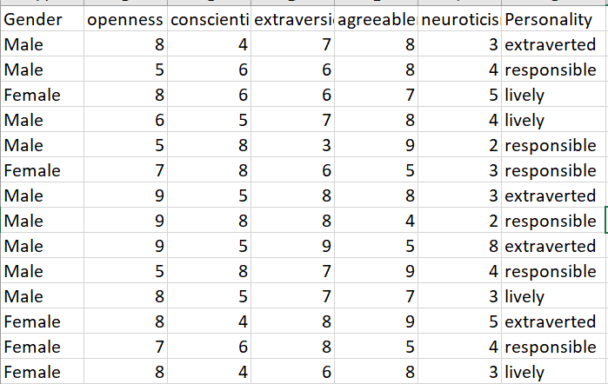
Data example:

Slide 12

Prepare the data
This step is also famously known as cleaning the data.
Based on the model check weather the features in the data set is suitable or not.
Check if the data contains missing or NULL values, if so handle it.
Divide the data into training and testing data with balanced amount of data we have for each result.

Slide 13
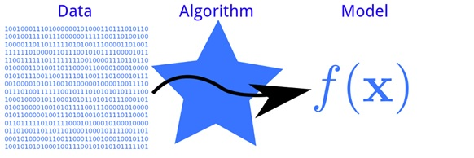
Choose the model
There are several models that you can choose according to the objective that you might have: you will use algorithms of classification, prediction, linear regression, clustering, i.e. k-means or K-Nearest Neighbor, Deep Learning, i.e Neural Networks, Bayesian, etc.
There are various models to be used depending on the data you are going to process such as images, sound, text, and numerical values.

Slide 14
Train the machine model
Train the machine learning model by using the algorithm that we have choose.
Choose the parameters with different combination parameters into the algorithm.
Fit the model by feeding the training data.

Slide 15
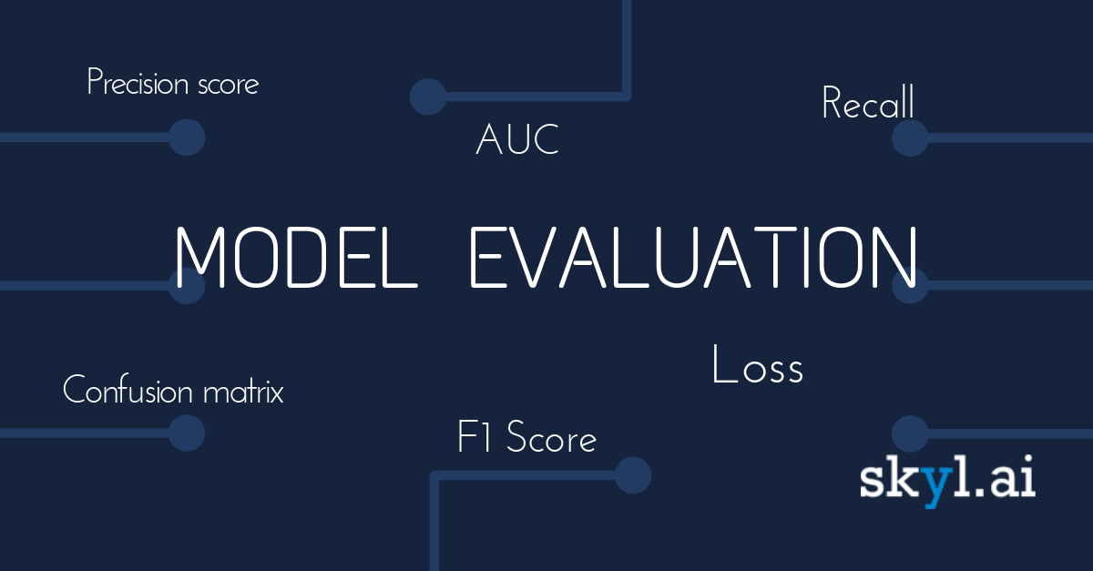
Evaluation
You will have to check the machine created against your evaluation data set that contains inputs that the model does not know and verify the precision of your already trained model. If the accuracy is less than or equal to 50%, that model will not be useful since it would be like tossing a coin to make decisions. If you reach 90% or more, you can have good confidence in the results that the model gives you.

Slide 16
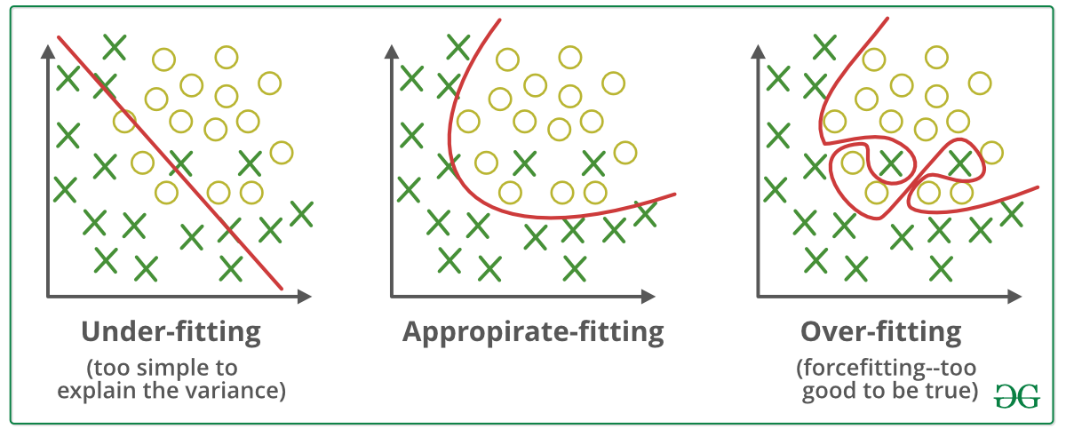
Parameter Tuning
If during the evaluation you did not obtain good predictions and your precision is not the minimum desired, it is possible that you have overfitting -or underfitting problems and you must return to the training step before making a new configuration of parameters in your model. You can increase the number of times you iterate your training data- termed epochs.

Slide 17

Prediction or Inference
We are now ready to use your Machine Learning model inferring results in real-life scenarios.

Slide 18
Applications:
Job performance prediction.
Better understand other people.
Identify their likes and dislikes.
Know which situations are ideal for them.
Recognize their strengths and weaknesses.

